Slide 1


Improving sales of Apple & Samsung
Instructor: Shivaji Rao
By : Sai Charan Reddy, Shivani Mehta

Slide 2
Goal: To improve the sales and Business
As a Data Science students we used Natural Language Processing techniques to solve this problem.

Slide 3
Amazon Electronic Gadgets Reviews
We focused on Mobile market
Shortlisted the top two popular mobiles
1) Samsung
2) Apple

Slide 4
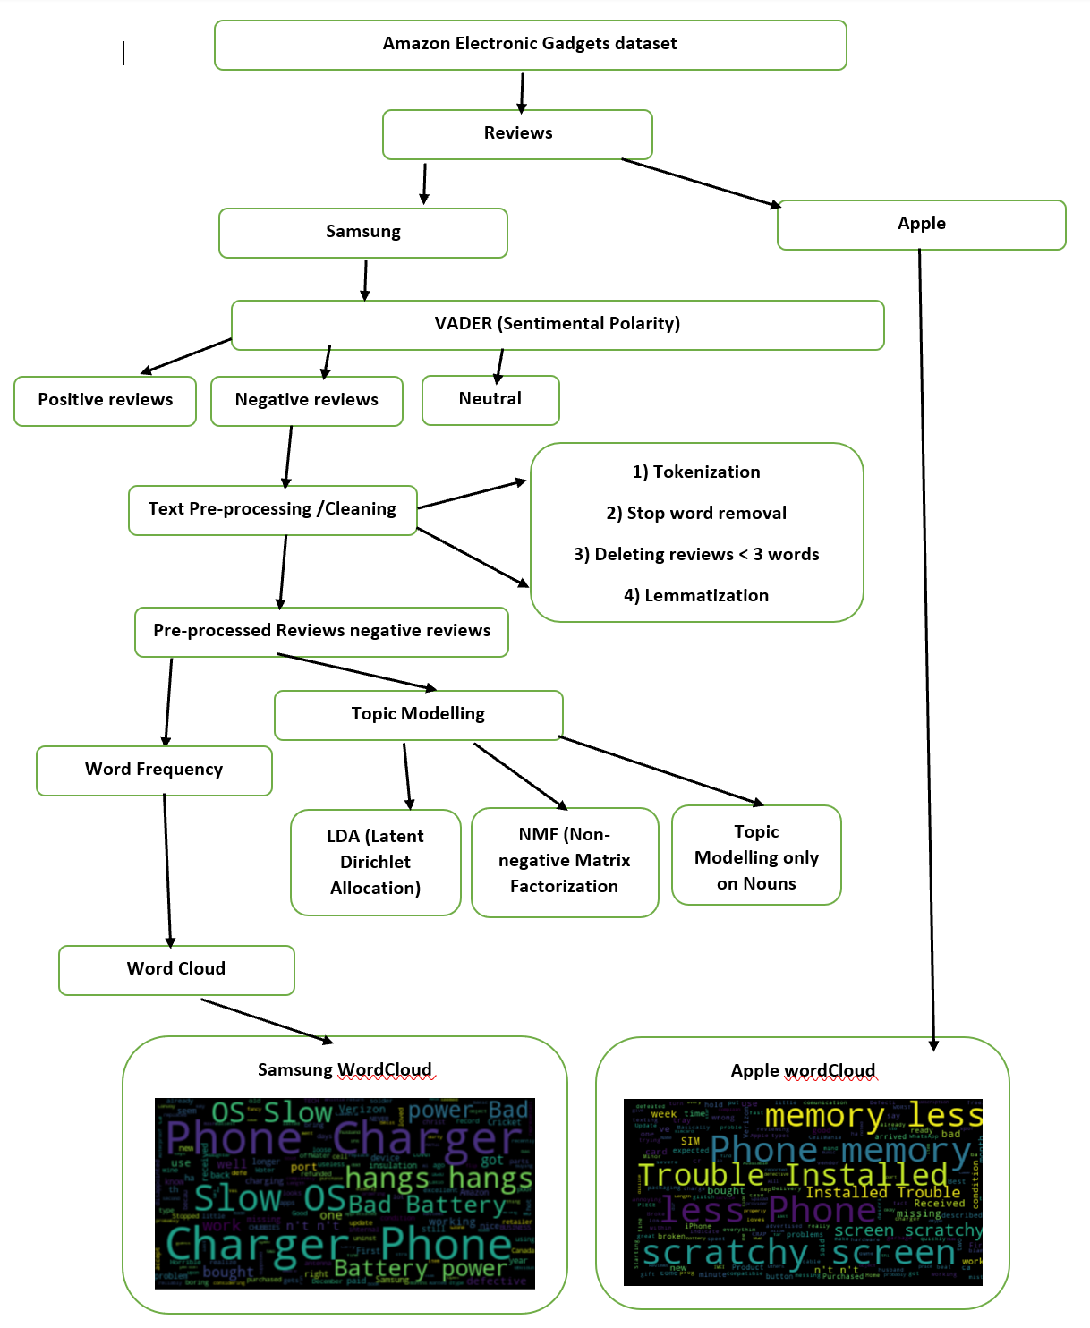
Project Architecture
.

Slide 5
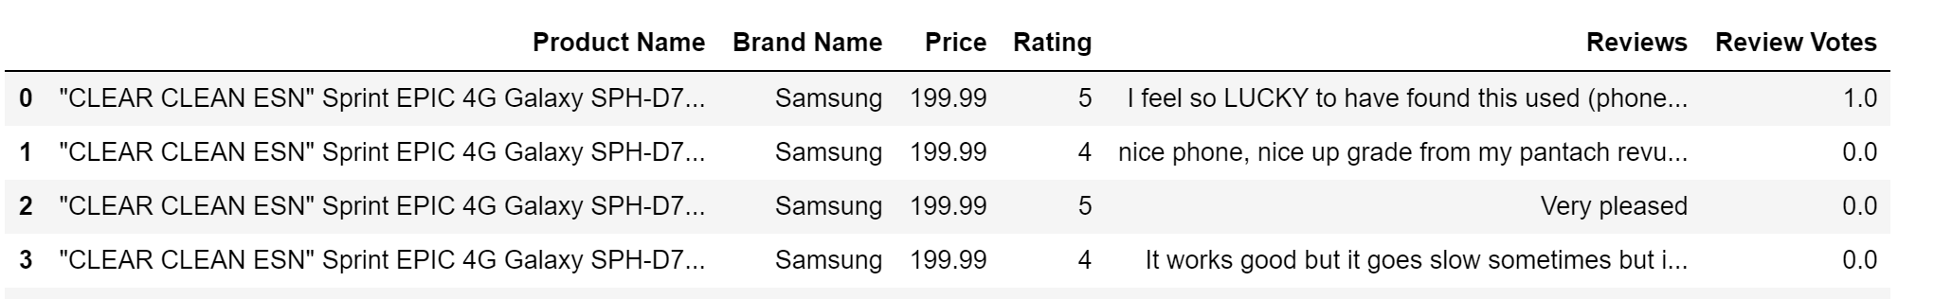
Features
Product Name
Brand Name
Price
Reviews
Votes

Slide 6
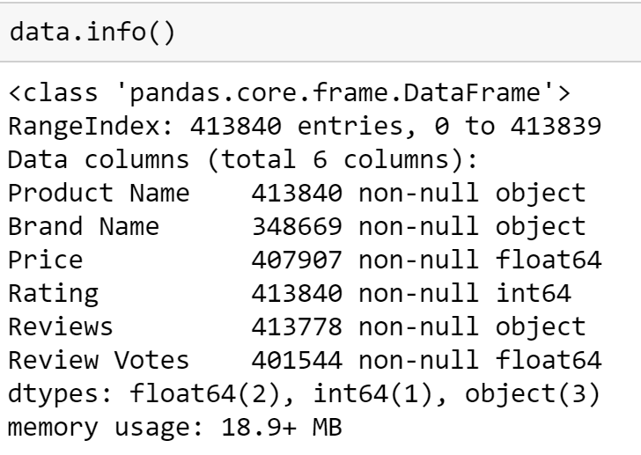
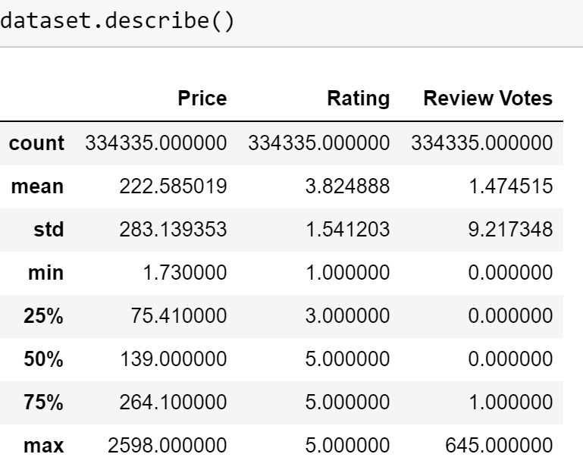
Exploratory Data Analysis

Slide 7
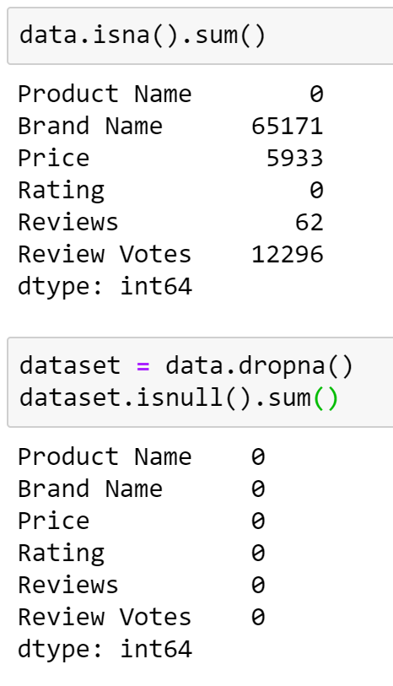
Data Cleaning

Slide 8
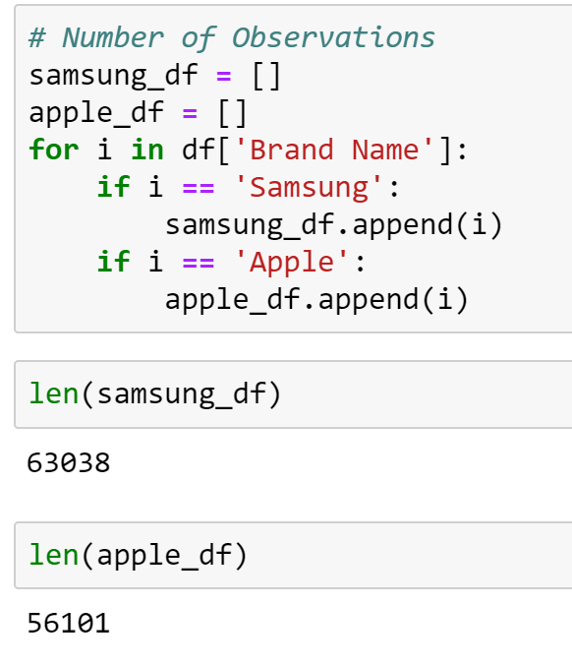
Number of Observations Samsung: 63k Apple: 56k

Slide 9
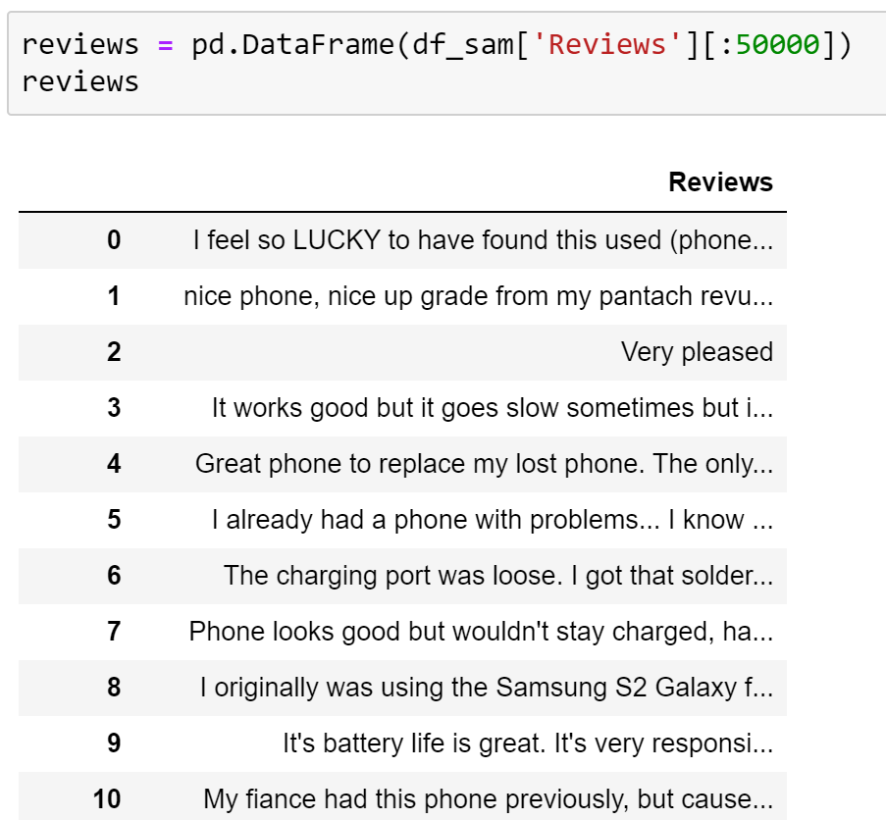
Number of observations considered for the project: 50k

Slide 10
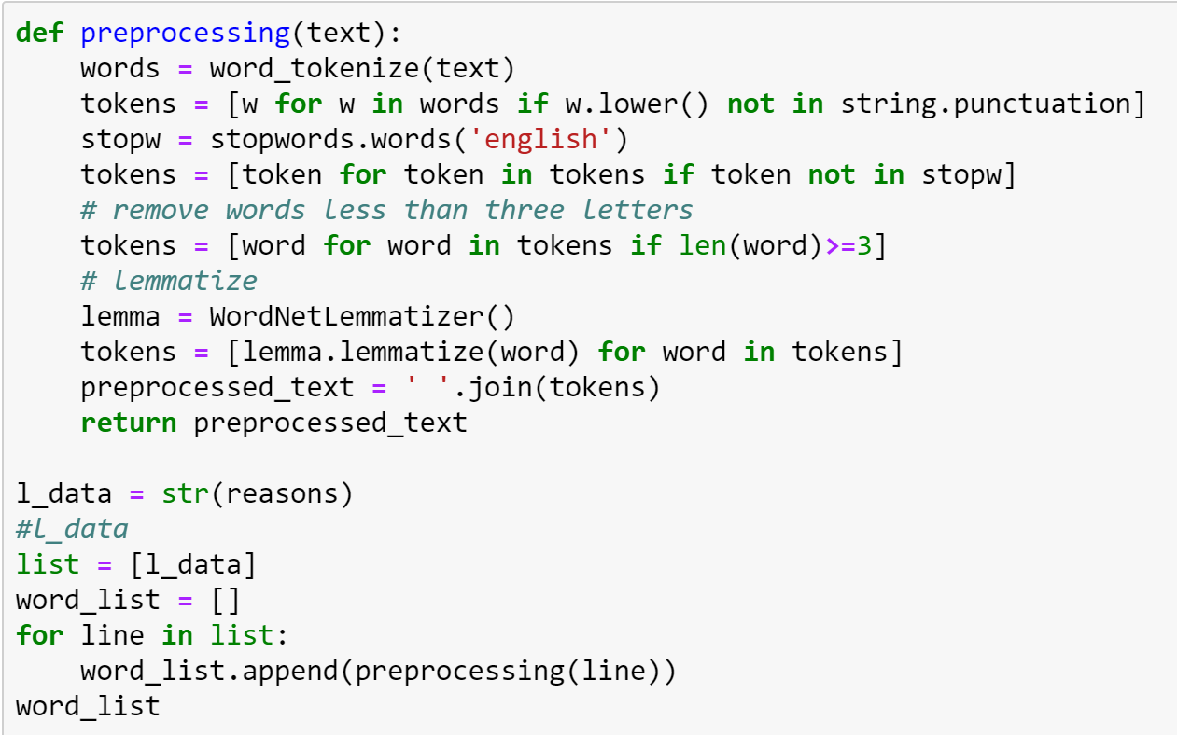
Text Pre-processing
Tokenization
Stop Words removal
Removing reviews that are less than 3 words
Lemmatization

Slide 11
VADER for Sentiment Polarity
VADER (Valence Aware Dictionary and Sentiment Reasoner)
It is a lexicon and rule-based sentiment analysis tool that is specifically used for sentiments

Slide 12
Conditions for different sentiments
VADER (Valence Aware Dictionary and Sentiment Reasoner) is a lexicon and rule-based sentiment analysis tool that is specifically attuned to sentiments
positive sentiment: compound score >= 0.5
neutral sentiment: (compound score > -0.5) and (compound score < 0.5)
negative sentiment: compound score <= -0.5
Compound score: is the sum of all of the lexicon ratings which have been standardized to range between -1 and 1

Slide 13
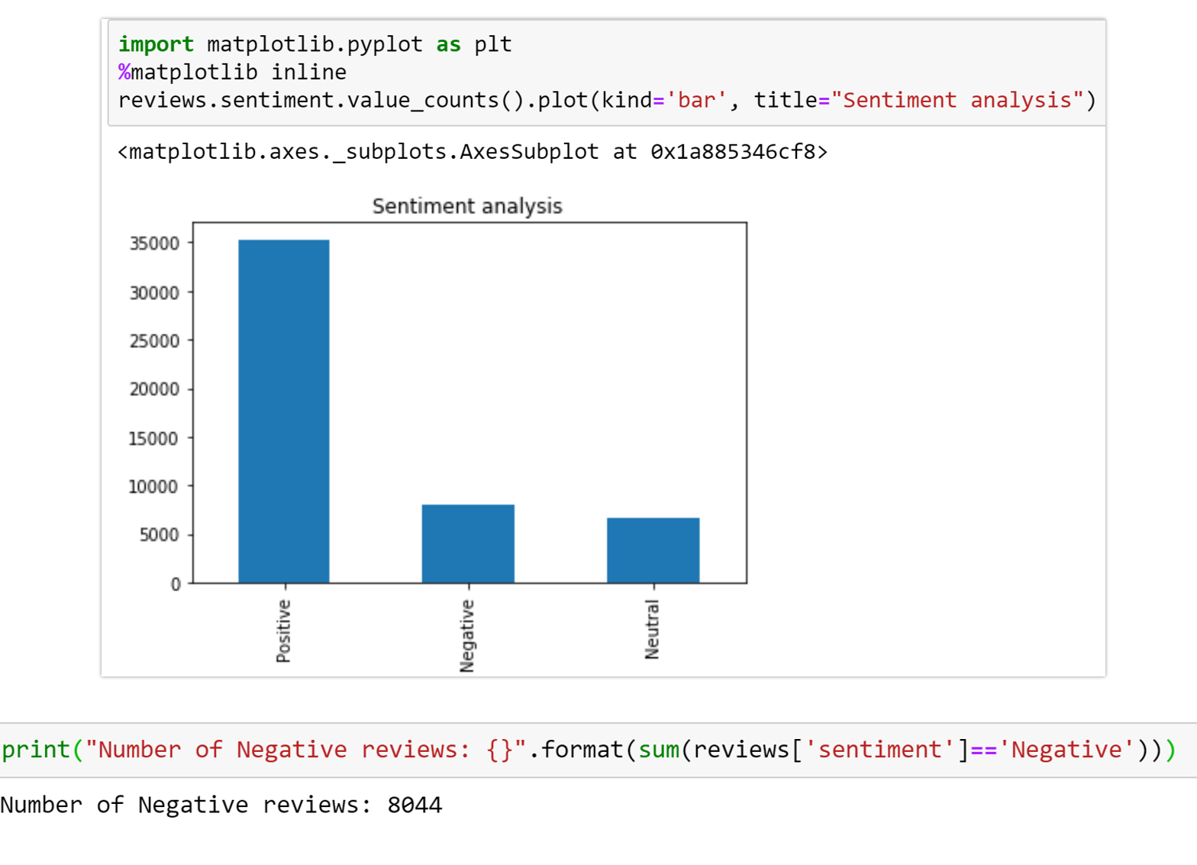
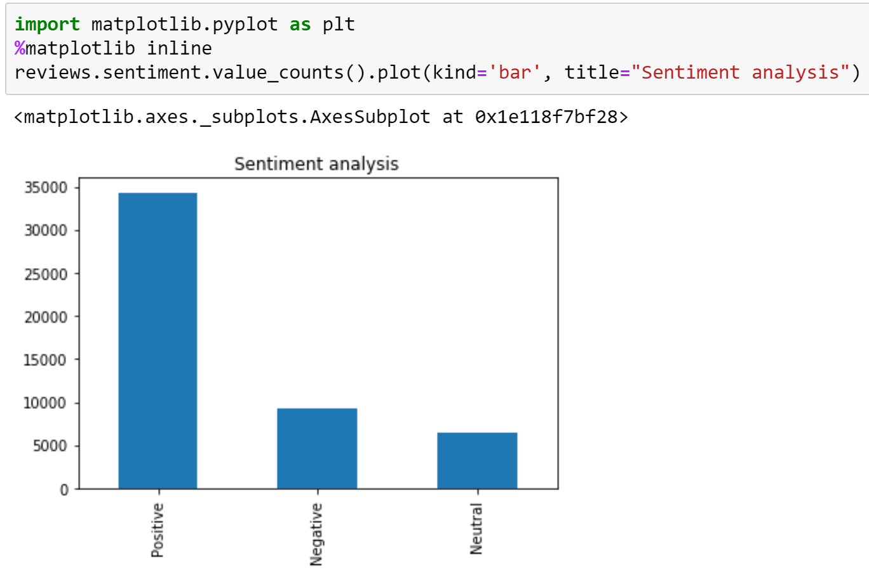
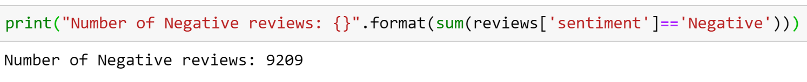
Plots of Sentiments for Samsung & Apple
Apple
Samsung

Slide 14
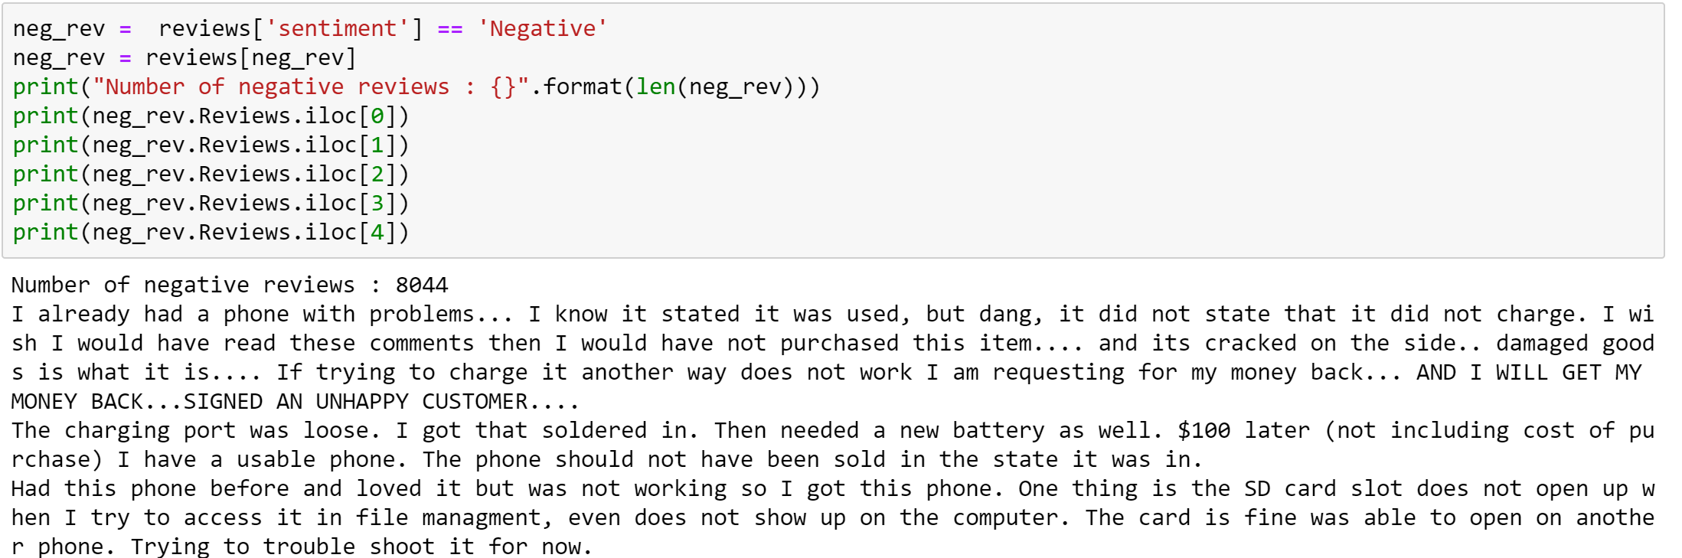
Filtering only Negative Reviews

Slide 15
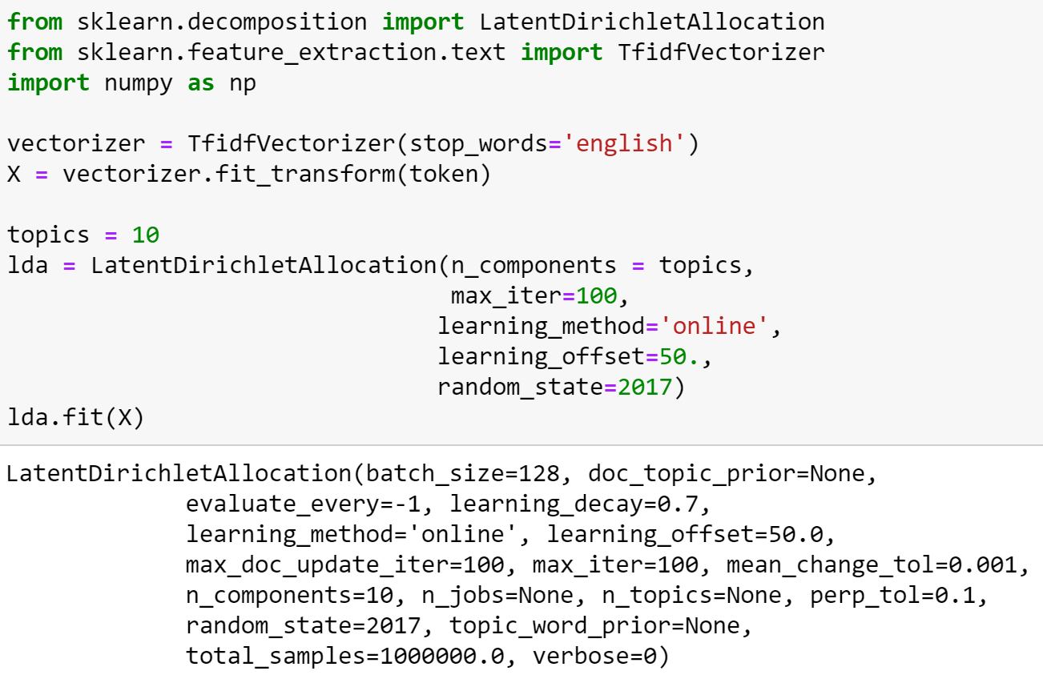
LDA (Latent Dirichlet Allocation)

Slide 16
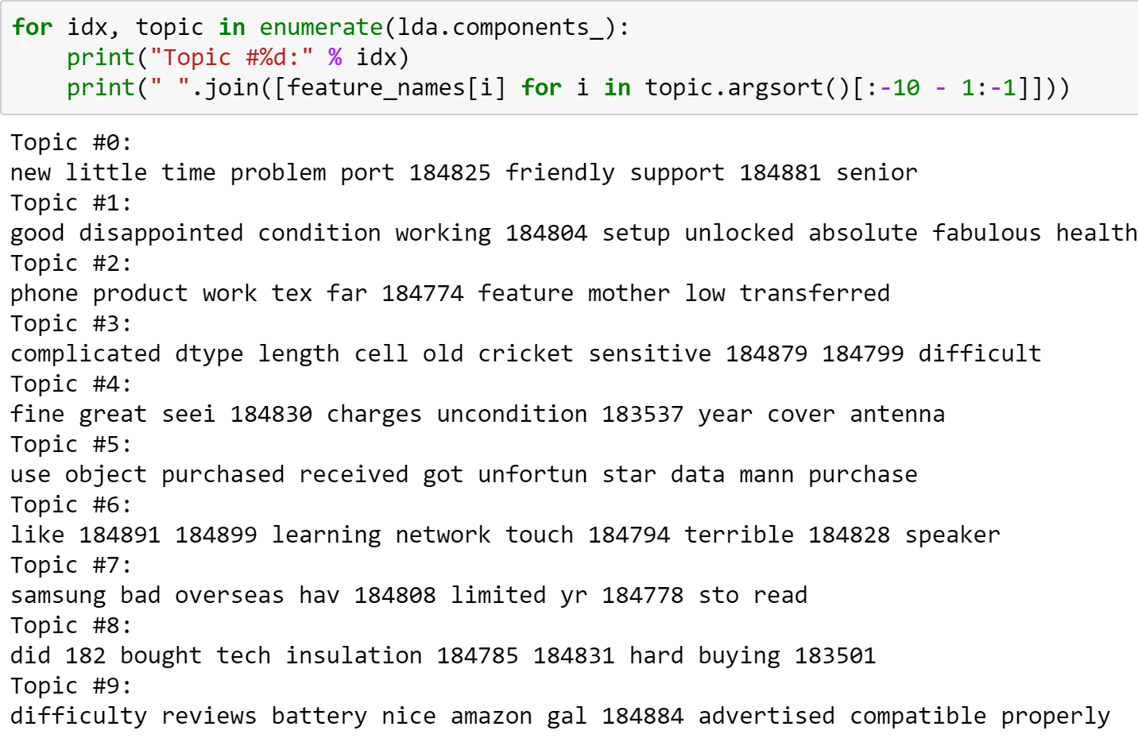
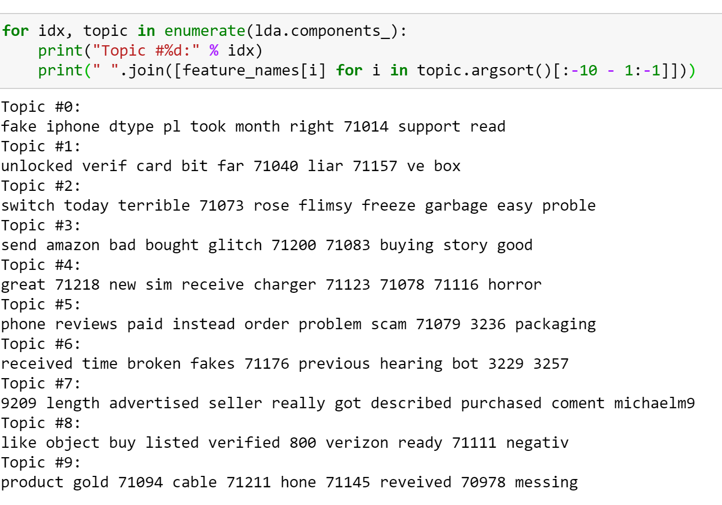
LDA Result
Samsung
Apple

Slide 17
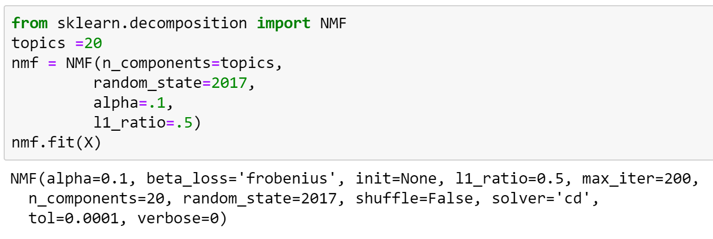
NMF(Non-negative Matrix Factorization)

Slide 18
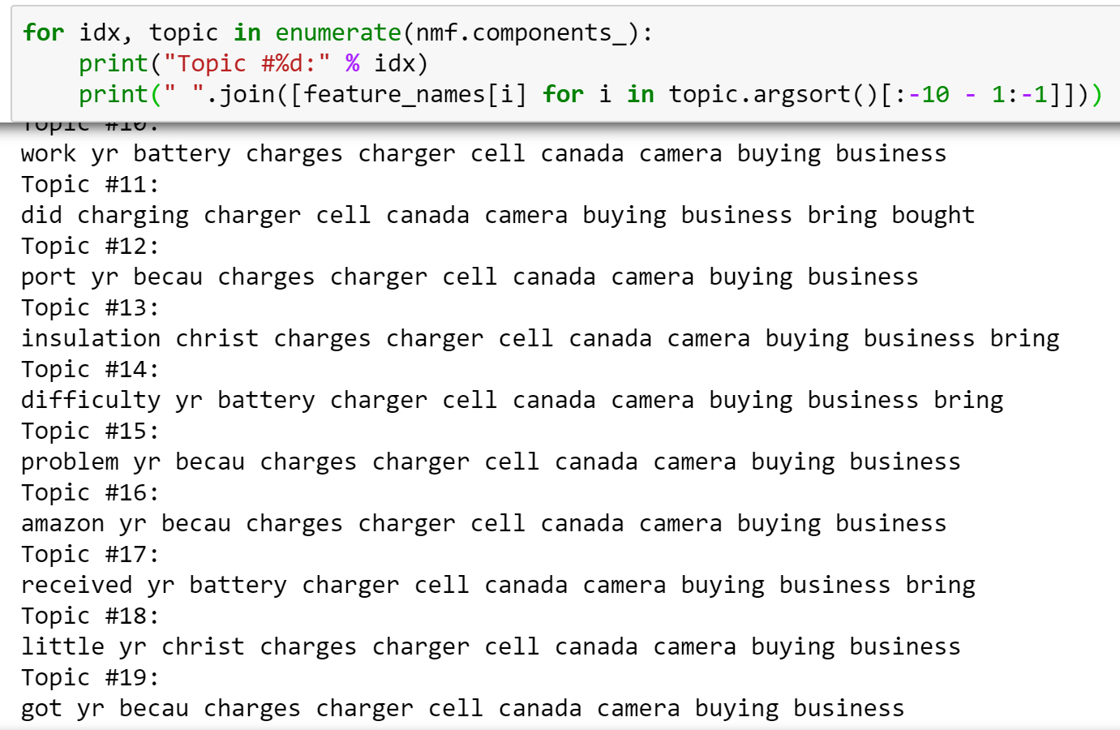
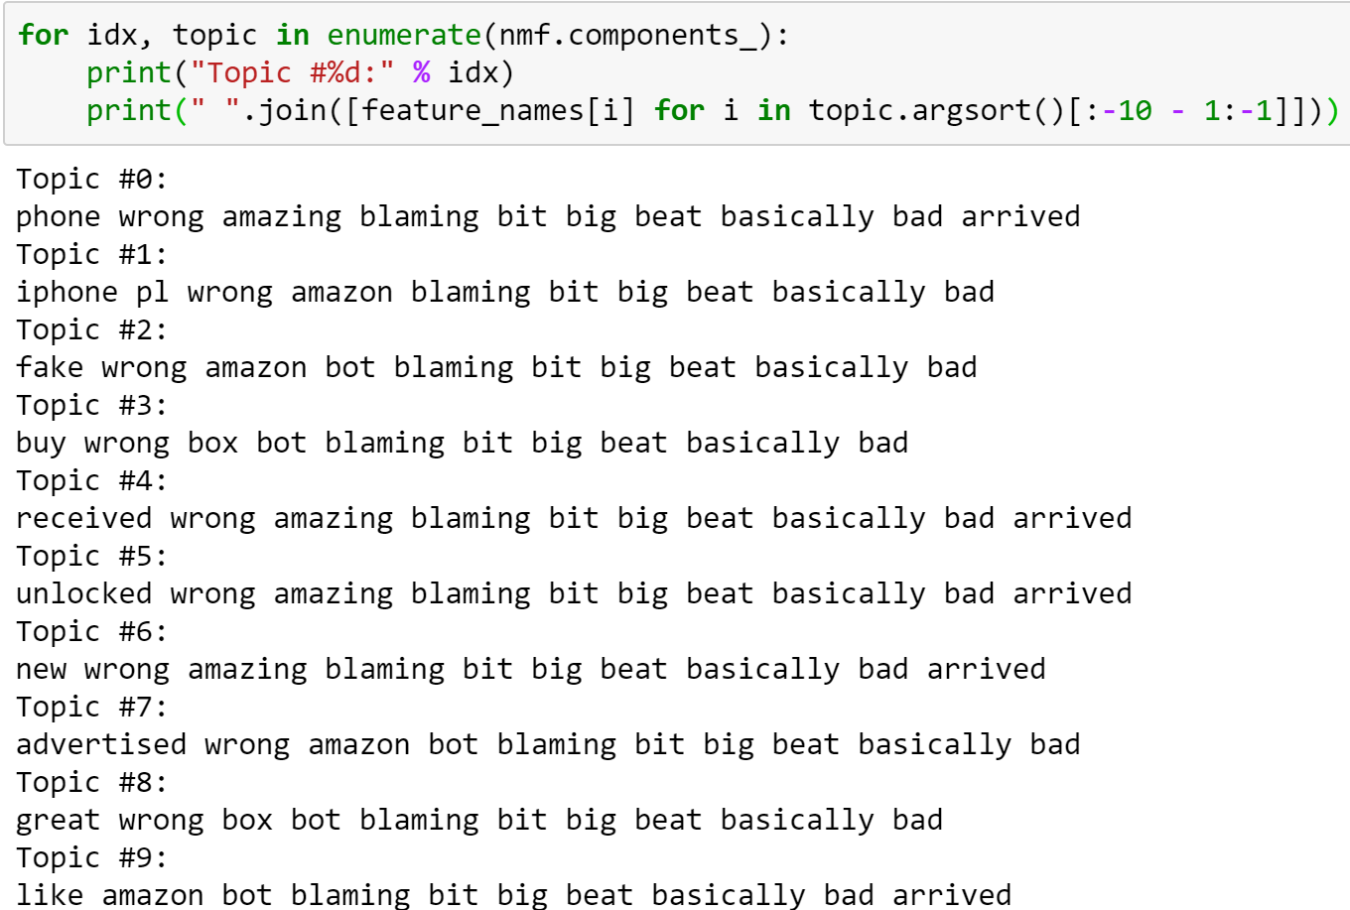
NMF Result
Samsung
Apple

Slide 19
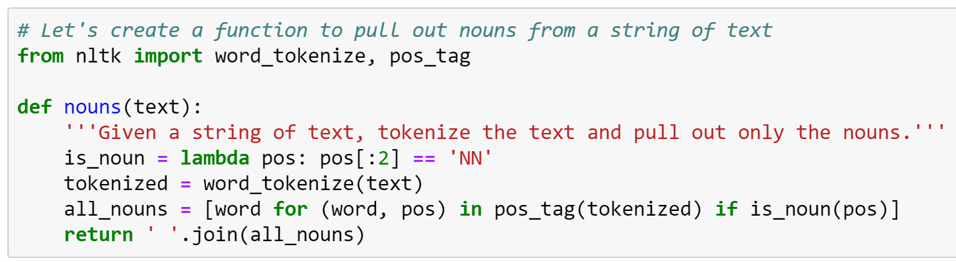
Topic Modelling only on Nouns

Slide 20
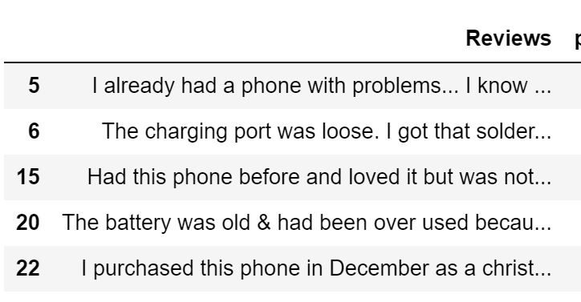
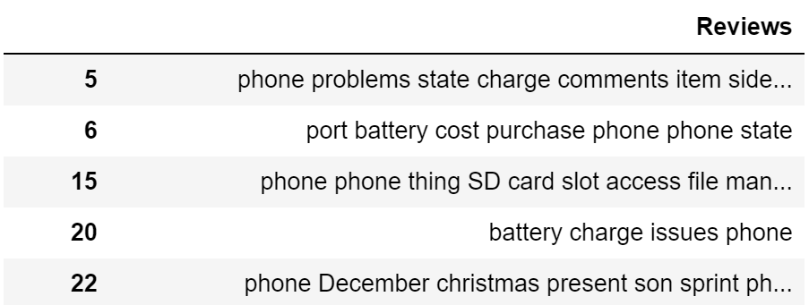
Result of extracting only Nouns
Reviews Before Extraction
Reviews after extraction

Slide 21
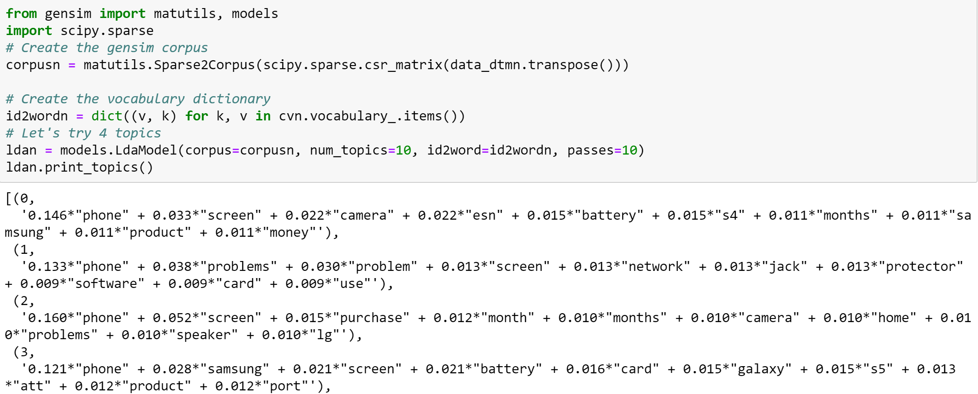
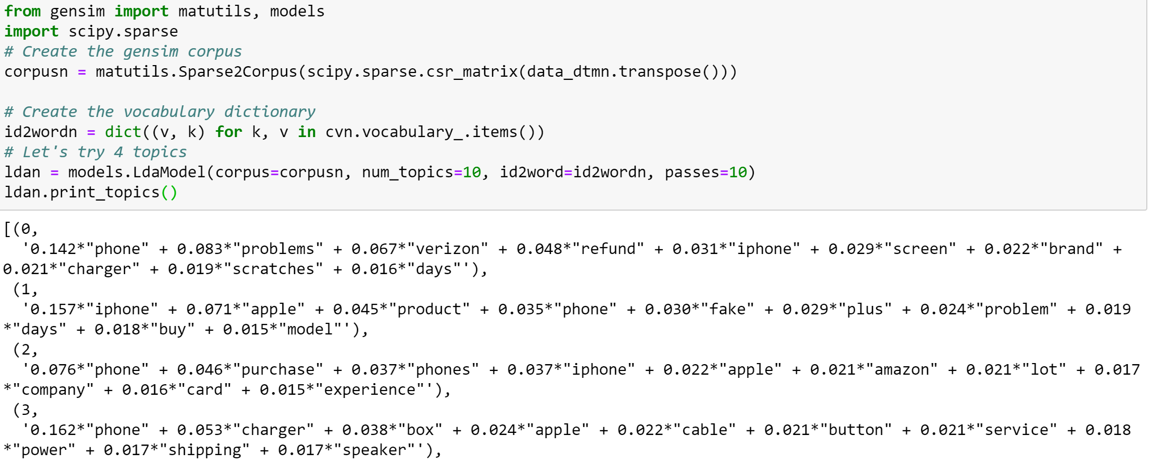
Result of Topic Modelling only on Nouns
Samsung
Apple

Slide 22
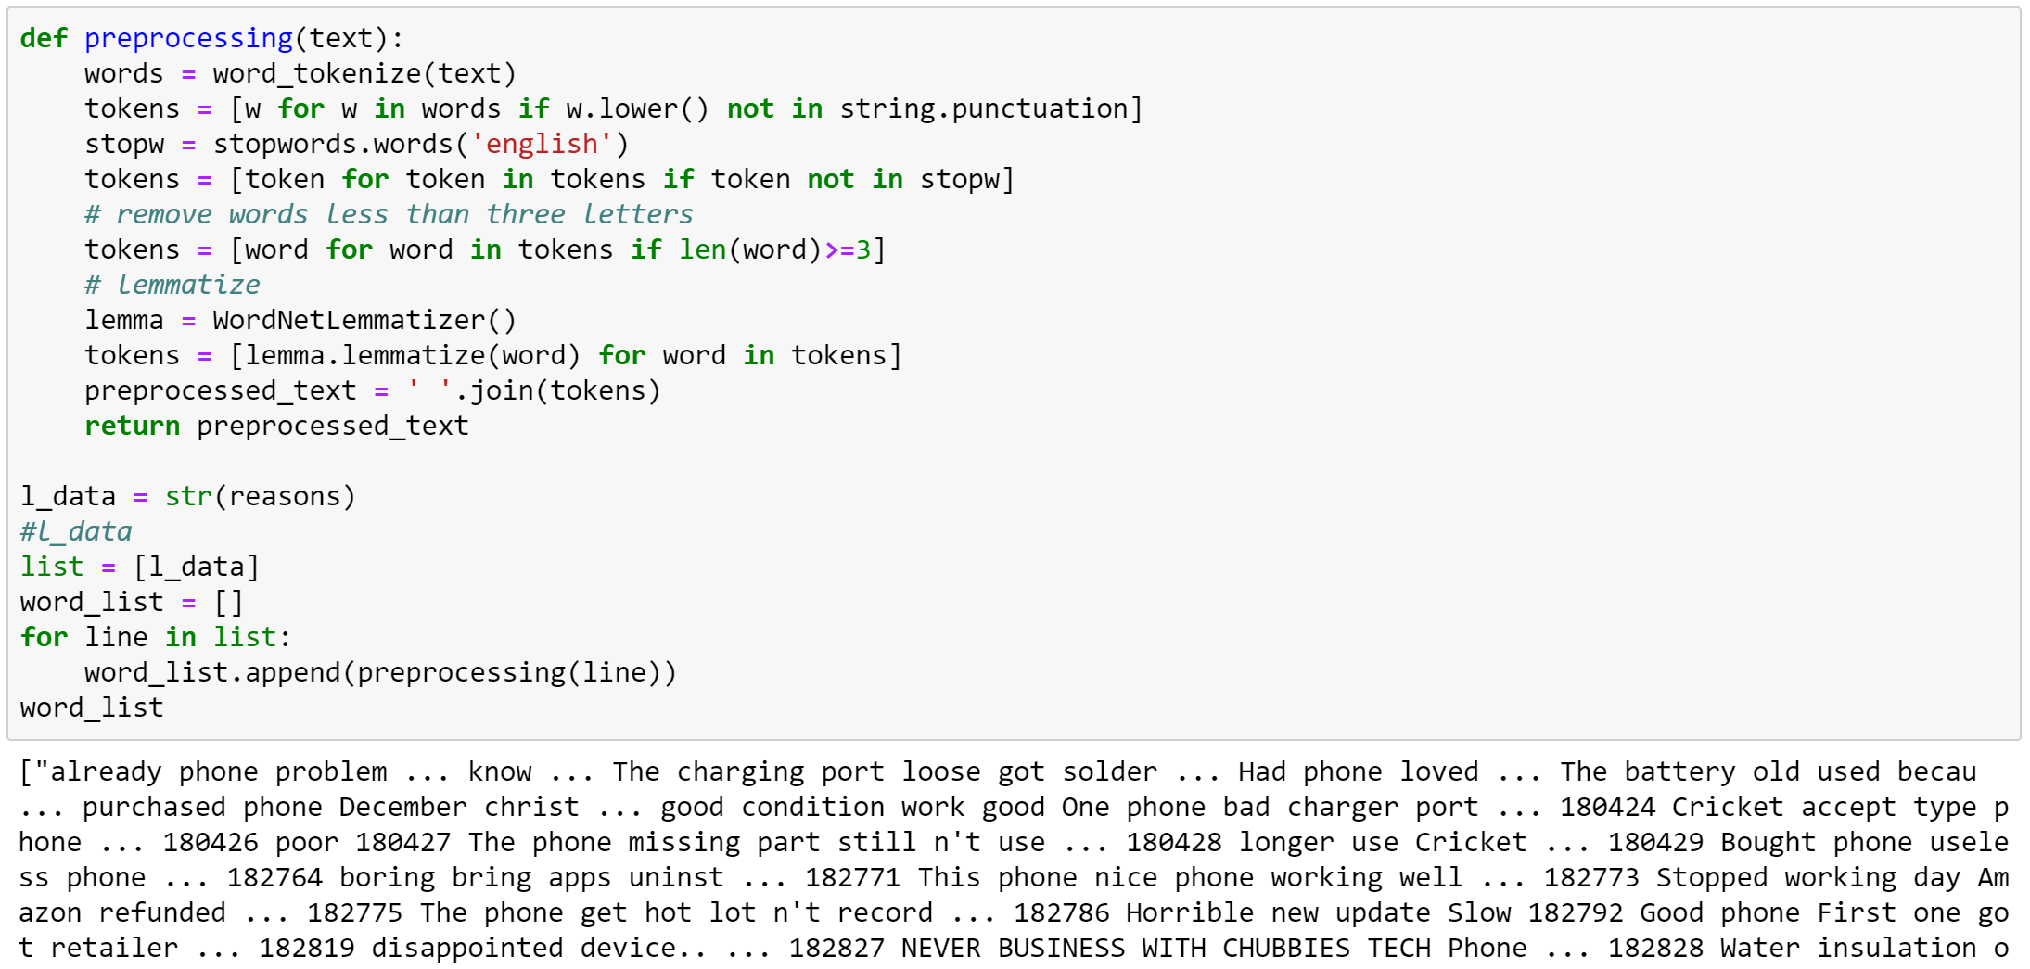
WordCloud Step-1 Text pre-processing only on Negative Reviews

Slide 23
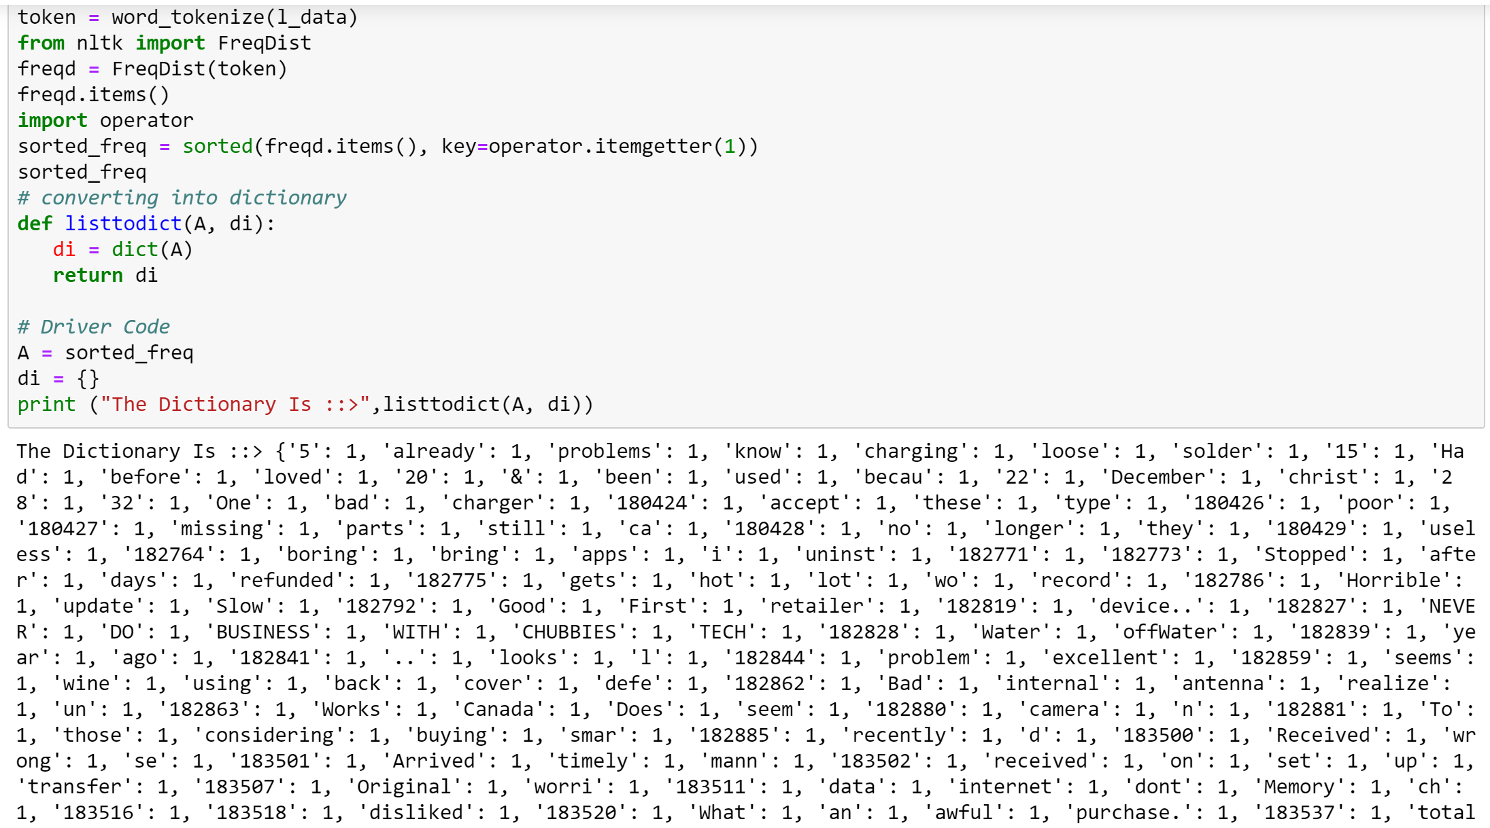
Step-2 Converting all the text tokens, Dictionary, and sorted based on Frequency of words

Slide 24
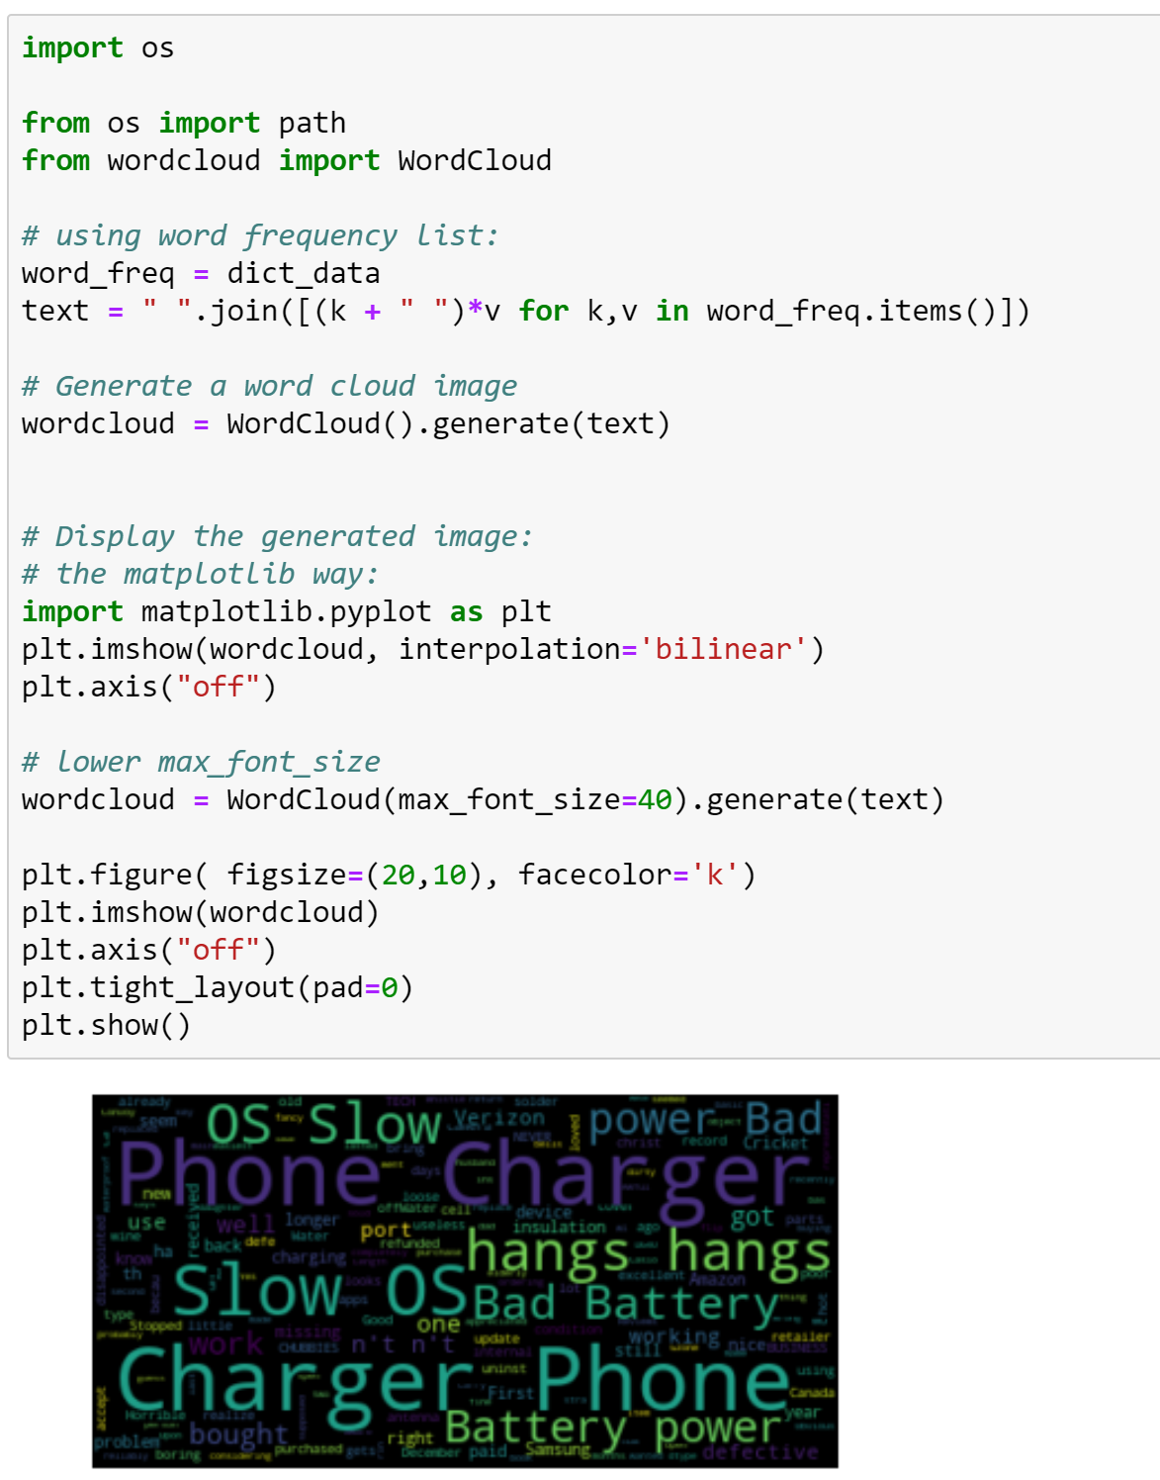
Code for plotting the WordCloud

Slide 25
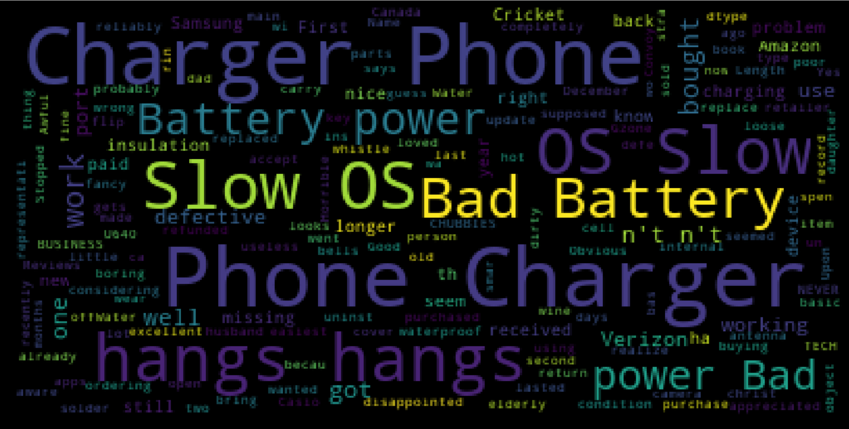
Word Cloud for Samsung Mobile ___________ (Slow OS, OS bad, hangs) (Bad Battery, Phone Charger, disappointing Battery power, power Bad)

Slide 26
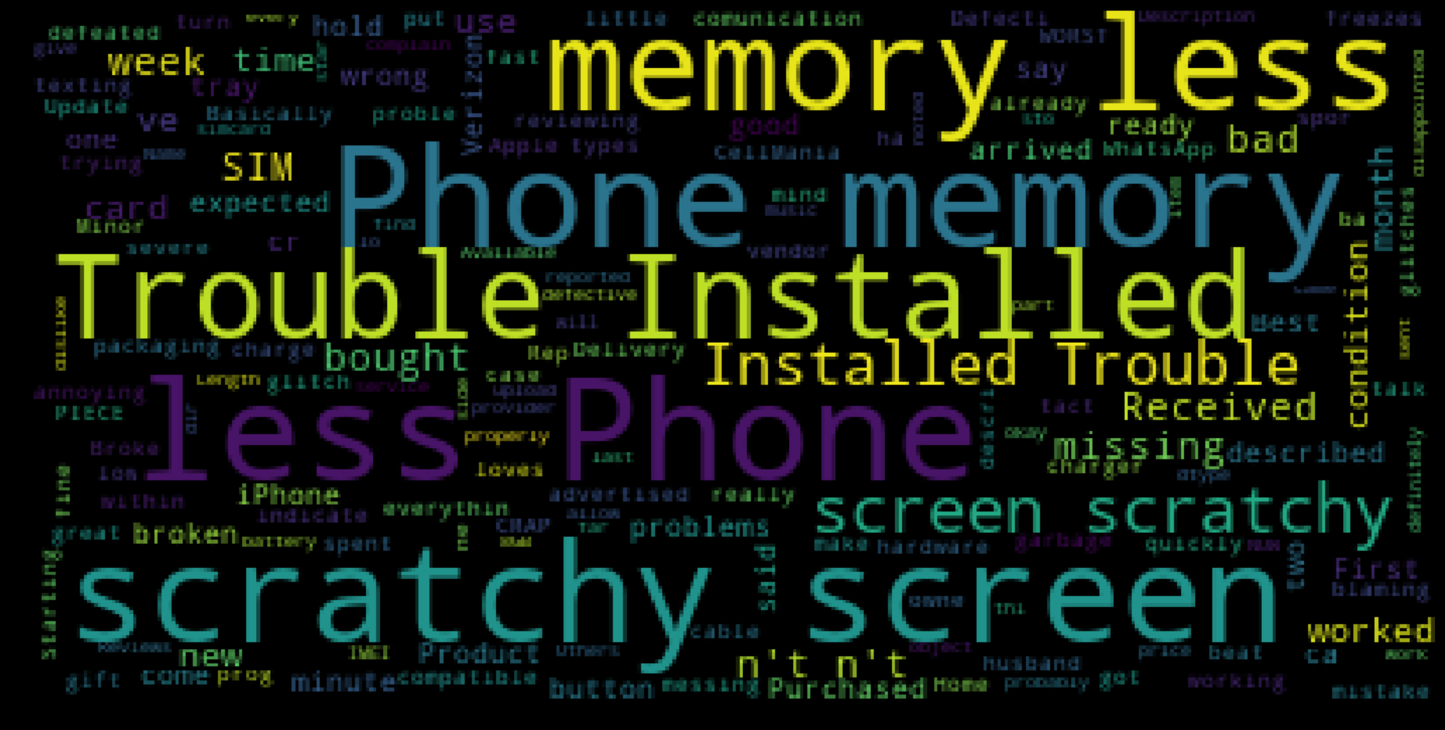
Word Cloud for Apple Mobile
Trouble Installation
Conditional Installation Trouble
Scratchy Screen, Sim slot not working,
Less memory

Slide 27
Negative Topics on Samsung & Apple
Samsung | Apple
Operating System Slow OS, OS bad, Hangs | OS Installation Problem Trouble Installation, Conditional Installation Trouble
Battery Problems Bad Battery, Disappointing Battery power, | Damaged parts Scratchy Screen, Sim slot not working, Less memory
Items not working Phone Charger, Power Bad | Missing Items Broken Battery Missing Charger, Earphones
TOPICS : OS BATTERY POWER MISSING ITEMS | TOPICS: INSTALLATION, SCREEN DAMAGED, DAMAGED BATTERY, LESS MEMORY, MISSING ITEMS

Slide 28
Thanks

